Slide 1
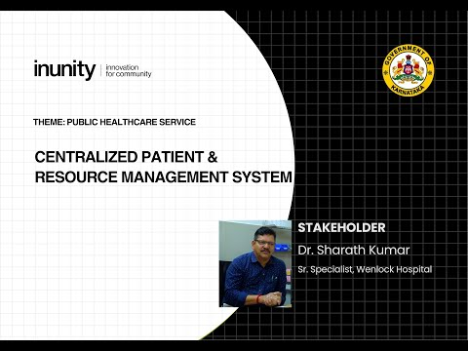
CPRMS Display+: A Modular Smart Display System
Shallen Crissle Sequeira

Slide 2
Agenda
1
2
3
4
5
Problem Statement
Solution
Flow diagram
Technology used
Estimated performance

Slide 3
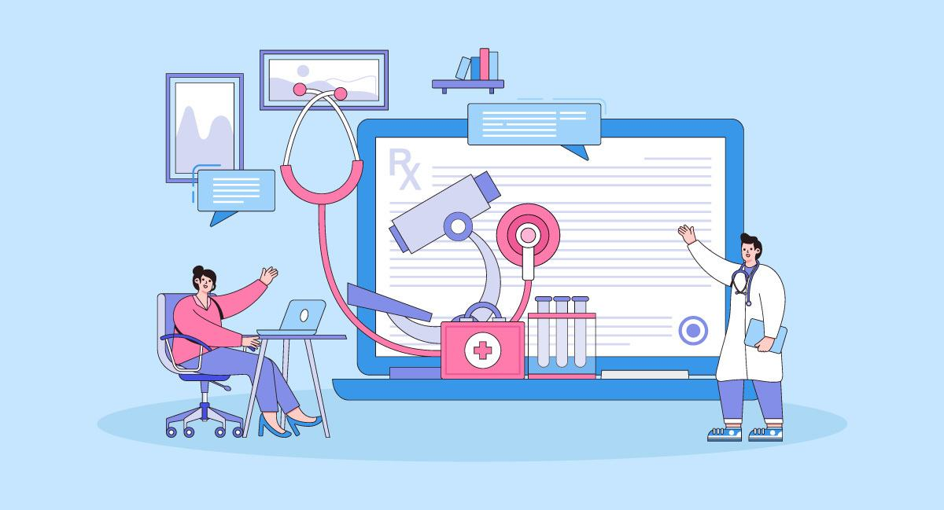
Problem Statement
Wenlock Hospital currently faces fragmented communication across departments like Cardiology, OT, and Pharmacy. Despite having 73 display screens and a drug inventory system, there's no unified platform to manage OT schedules, display real-time updates, or broadcast emergency alerts.
​

Slide 4
Solution
1. Digital Token & Queue Management | Patient registers at the central kiosk and selects the desired department. A unique token ID (e.g., G-1) is auto-generated and sent via SMS, replacing physical slips. At departments, staff digitally mark patient arrival, feeding them into a real-time FIFO queue. Digital displays show live queue status, reducing physical congestion.
2. Digital Prescription & Pharmacy Integration | Doctors issue e-prescriptions, assigned a unique Prescription ID. Patients receive the prescription via SMS or WhatsApp (PDF/image format). The pharmacy system fetches prescriptions using the ID, scans QR-tagged drugs, and checks real-time inventory. Patients are instantly notified of stock availability or alternatives. Inventory is updated automatically upon dispensing.
3. Real-Time OT Scheduling | Doctors log in using biometrics or facial recognition, confirming availability. The OT scheduler checks for: Doctor presence OT room availability Existing bookings A conflict-free OT schedule is created dynamically.

Slide 5
Solution
4. Emergency Alert Broadcast | Authorized personnel can trigger Code Blue / Code Red alerts from the system. Alerts are instantly broadcast on all hospital digital displays.
5. Backend Cloud & AI Analytics | All systems — tokens, prescriptions, inventory, OT — are cloud-synced. AI modules analyze: Drug demand forecasts Queue congestion detection Doctor-patient load balancing Schedule optimization

Slide 6
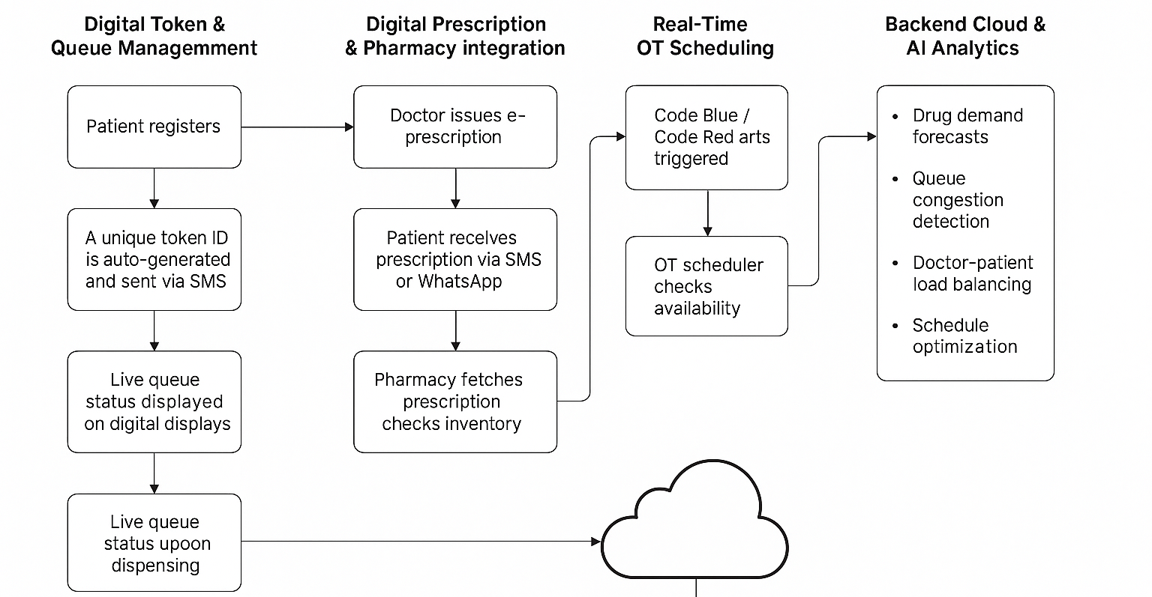
Flow Diagram

Slide 7
Technology Stack
 | Component | Technology/Tool | Purpose
1 | Frontend | React.js + Tailwind CSS | Build responsive UI and patient/staff dashboards
2 | Backend | Flask or Node.js APIs | Handle business logic, APIs, authentication, and routing
3 | Database | Firebase Realtime DB / MongoDB Atlas | Store tokens, prescriptions, queue status, and inventory
4 | AI/ML | Python-based modules | Predict queue congestion, stock demand, optimize scheduling
5 | Messaging | Twilio API / WhatsApp Cloud API | Send SMS/WhatsApp messages for tokens and prescriptions
6 | Biometrics | Aadhaar API / Facial Recognition SDK | Authenticate doctor presence for OT scheduling
7 | Hosting | Render / AWS / Azure Cloud | Deploy and scale the application with real-time syncing

Slide 8





Expected Impact
60–80% reduction in patient wait time through dynamic token management
100% paperless prescription workflow, improving patient safety
Real-time pharmacy inventory, avoiding stock-outs and manual errors
Improved OT utilization through dynamic scheduling
Enhanced transparency with live doctor availability and emergency alerts

Slide 9
THANK YOU

